Slide 1

Hotel Booking Web
Team Strikers

Slide 2
Team and Contribution
Rohan Patel: Build Hotel Search page and APIs
Zi Shun Yang: Build Backend-APIs
Govinder Somal: Build Customer-related pages, prepare Project Journal
Allen Wu: Build Homepage and Employee-related pages, prepare Project Journal, Sprint Task, and Project Board

Slide 3
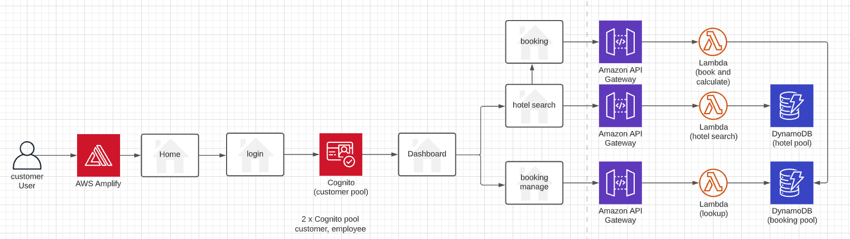
Project Architecture

Slide 4
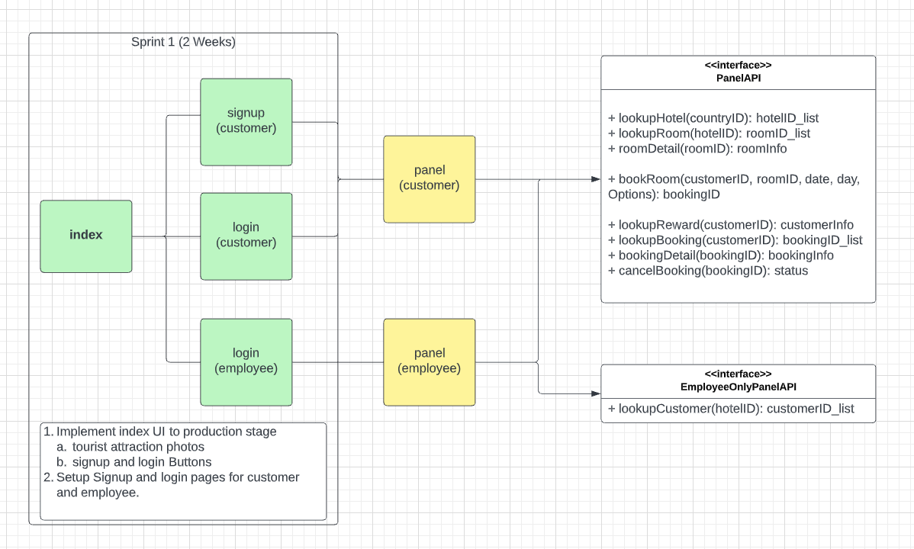
Detail

Slide 5
XP Principles
Pair Programming – conducted over zoom instead of in-person
Courage – encouraged each other when we were faced with bugs/difficulties
Communication – great communication between back-end and front-end team to get API’s working with front-end integration

Slide 6
Scrum Meetings
Conducted scrum meetings bi-weekly
3 Sprints towards the end of the week
Split into two teams which were Front-End and Back-End teams which worked out well
Used zoom/WhatsApp for communication

Slide 7
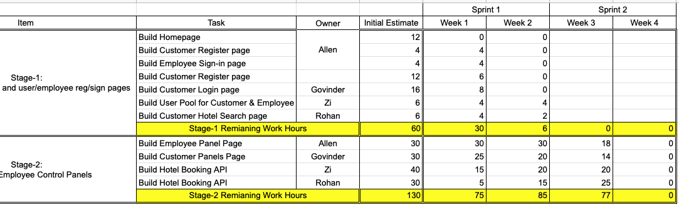
Scrum Task

Slide 8
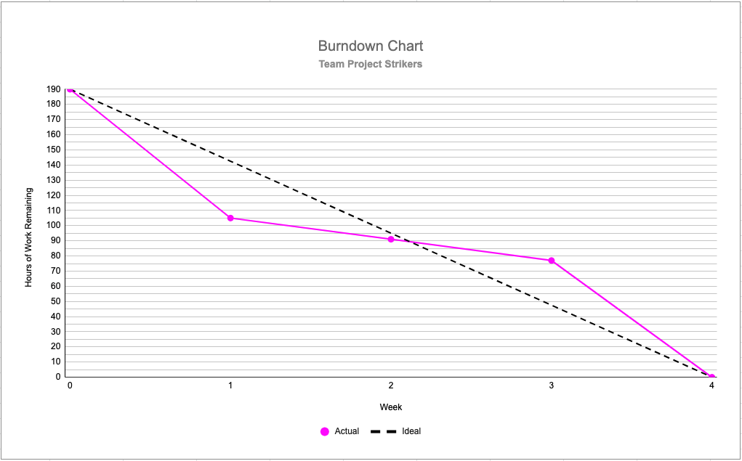
Burndown Chart

